Slide 1
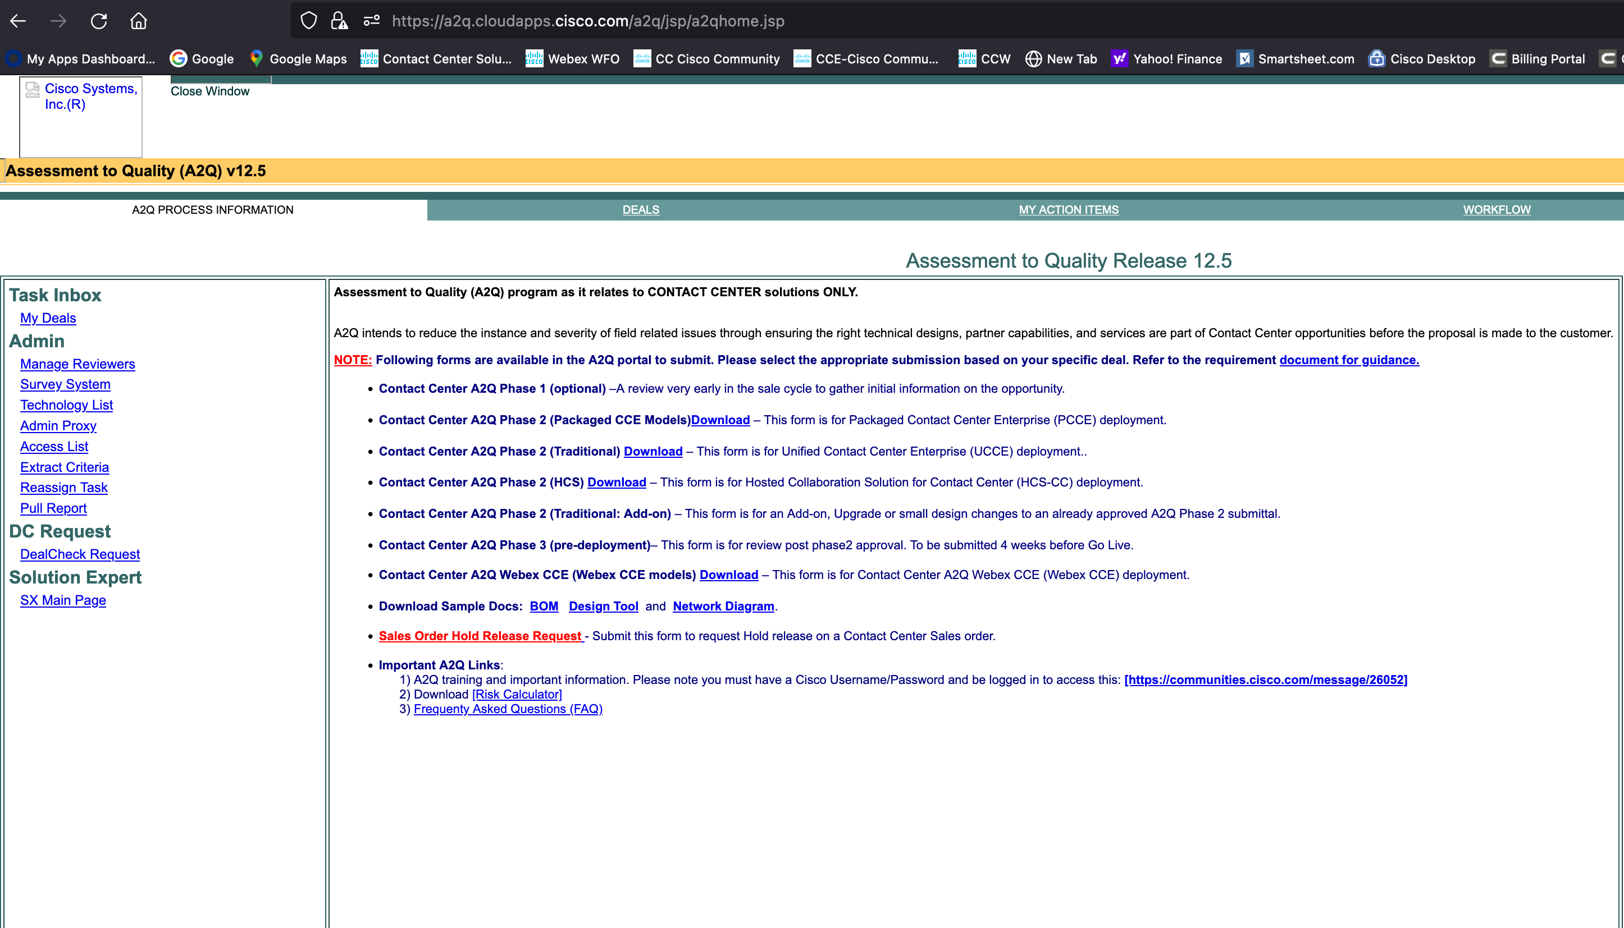
https://a2q.cloudapps.cisco.com/a2q/jsp/a2qhome.jsp

